Slide 1
Defining a Problem and Labeling Data
CS4981 ML Production Systems
RJ Nowling

Slide 2
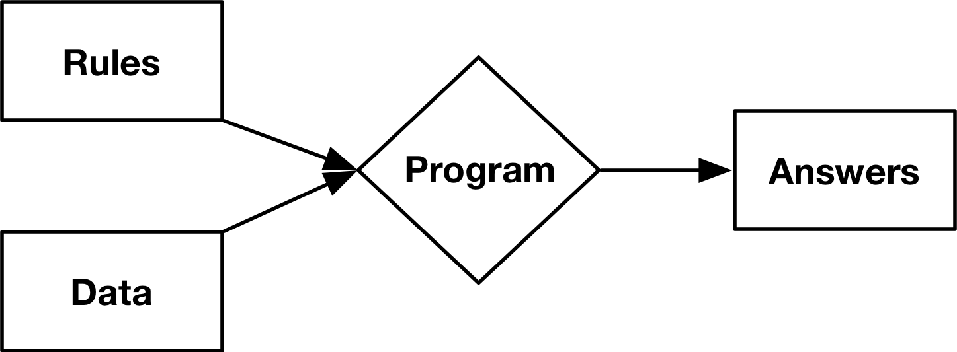
Traditional Programming

Slide 3
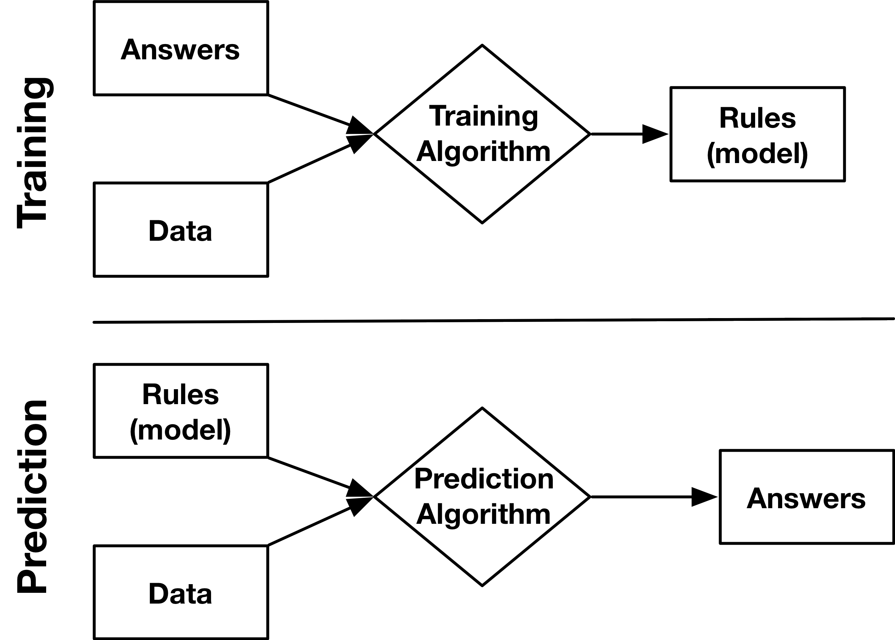
Supervised Machine Learning

Slide 4
Problem Types
Regression
Classification
Predicting a continuous numerical output
House price
Number of home runs
Stock price
Predicting a categorical output
Type of animal
Fraudulent or not
Spam or not

Slide 5
Supervised Learning Problem
Regression (continuous output):
How much will be this house sell for?
How large will an algae bloom be?
What will a students' GPA be at graduation?
Classification (categorical output):
Is the animal in the picture a cat or dog?
Is this a negative or positive review?
Is this genomic sequence a gene or not?

Slide 6
Models
Regression
Classification
Linear Regression
Random Forests
Support Vector Machines
Neural Networks
Logistical Regression
Random Forests
Support Vector Machines
Neural Networks

Slide 7
A Good ML Problem Definition
Is/Does
Is/Does Not
Specific
Defines the variable to be predicted and its type
Optionally, describes the metric used to evaluate the predictions
Optionally, specifies a desired performance
List a specific machine learning algorithm

Slide 8
Define a Problem
We want to predict the sale price for real estate transactions. We want the error of the predict prices to have a mean average precision of less than 5%. Regression
We want to predict whether the animal in a picture is a cat or dog. We want an accuracy above 90%. Classification

Slide 9
Supervised Machine Learning

Slide 10
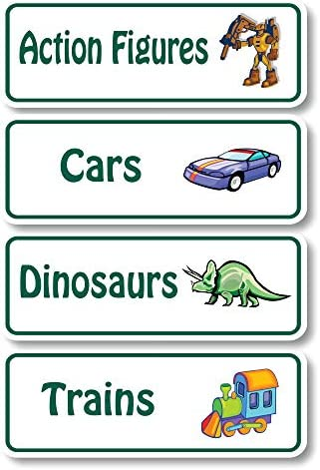
Label Quality
Model predictions can only be as accurate as the labels
Label accuracy can be impacted by:
Strength (confidence)
Reliability
Quantity

Slide 11
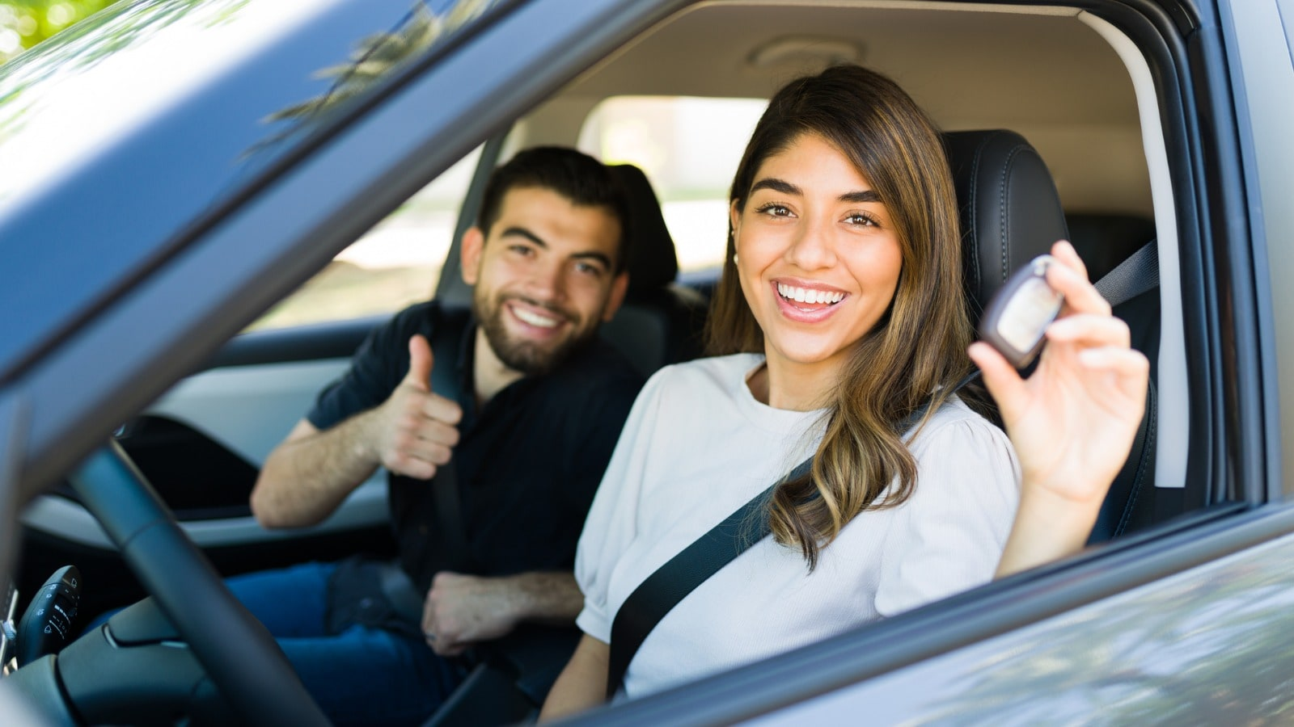
Label Quality: Confidence / Signal Strength
Poor correlation with the true label.
looking at cars online -> not a good indicator of purchasing a car
going to a physical dealership -> better indicator of purchasing a car

Slide 12
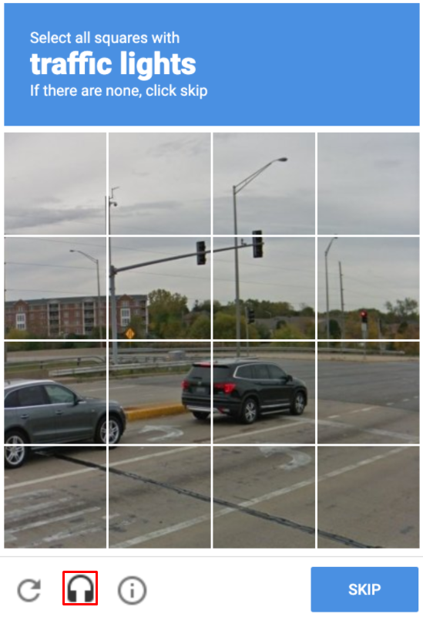
Label Quality: Reliability
Label measurements are not accurate – often get the label wrong
An unenthusiastic and unengaged worker is asked to fill out ton of reCAPTCHA prompts to test accuracy
They click randomly

Slide 13

Label Quality: Quantity
You may have very small sets of labeled samples
It can be costly to get data
E.g., experiments to gather sensor data for detecting home fires

Slide 14

Labeling Approach #1: Human Labeling
The most obvious way to label data is pay a human worker or use crowdsourcing

Slide 15
Labeling Approach #1: Human Labeling
Expensive, especially for more complex data
Slow
Inconsistent (e.g., detecting cancer in MRI scans)
Data privacy risks

Slide 16

Labeling Approach #2: "Natural Labels"
We are often trying to predict future events:
Will the user mark this transaction as fraudulent?
Will the user buy this item?
Will the user watch this movie we recommended?
If we wait long enough, we'll see if our prediction is true
We can go back and correct labels of predictions

Slide 17
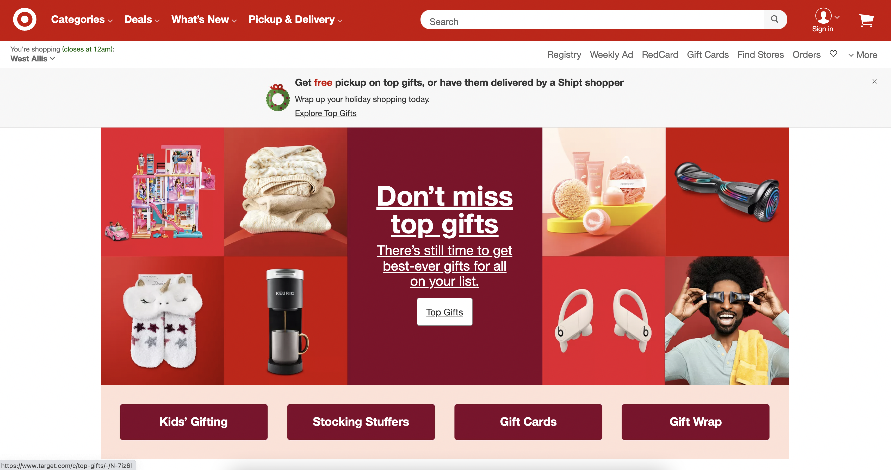
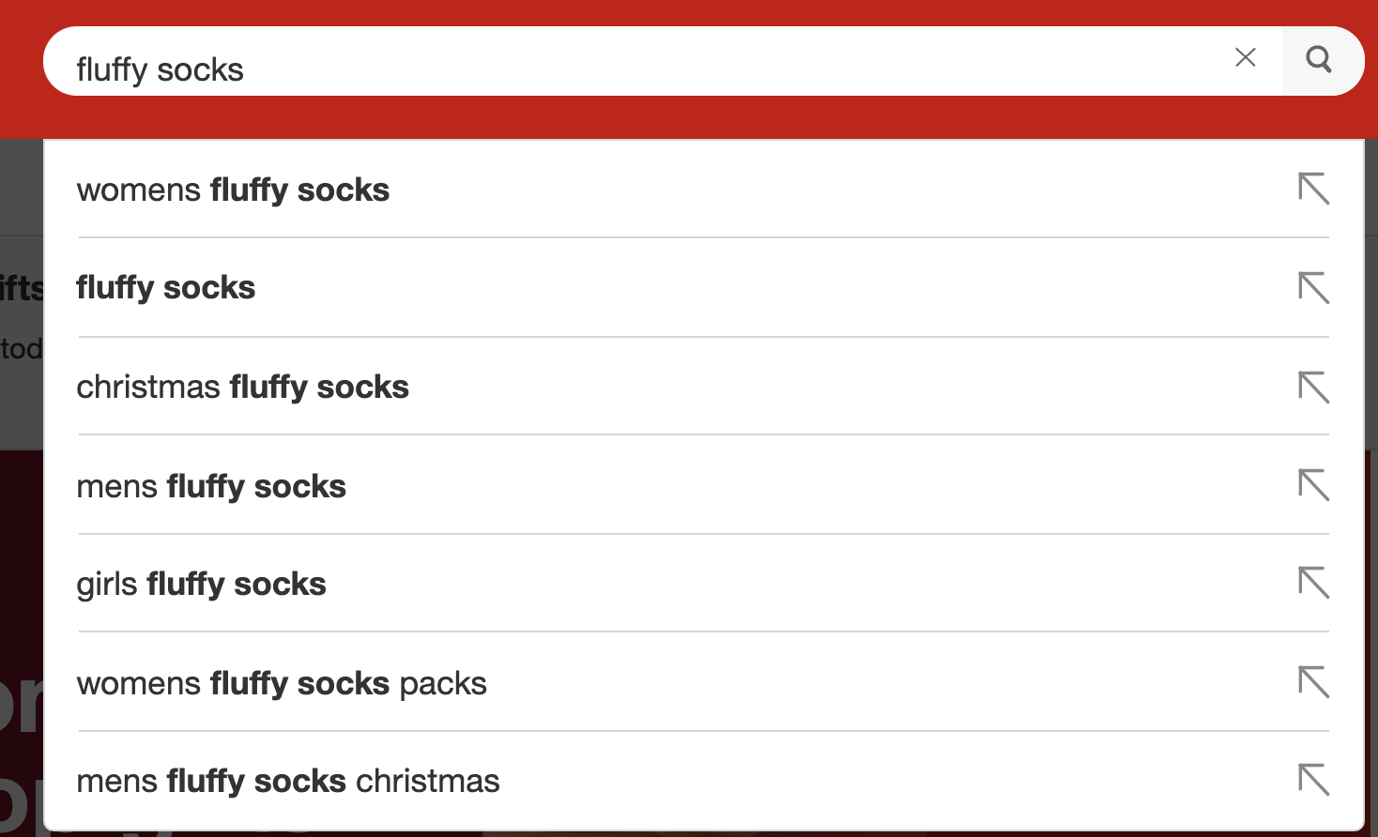
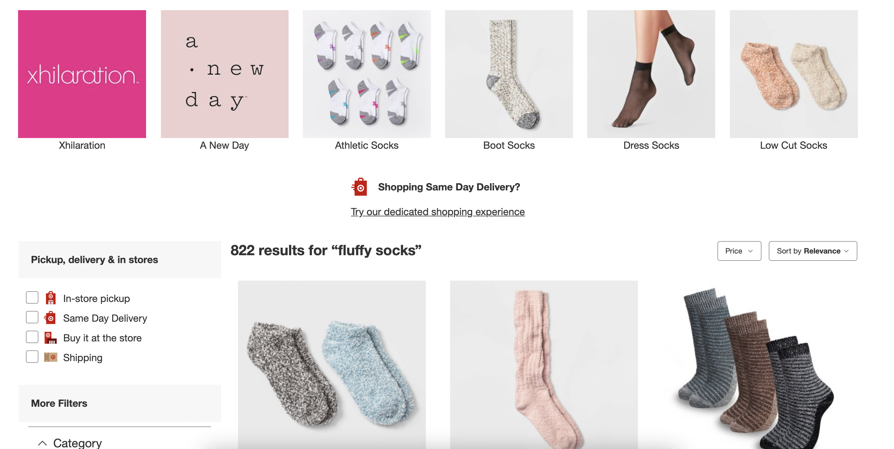
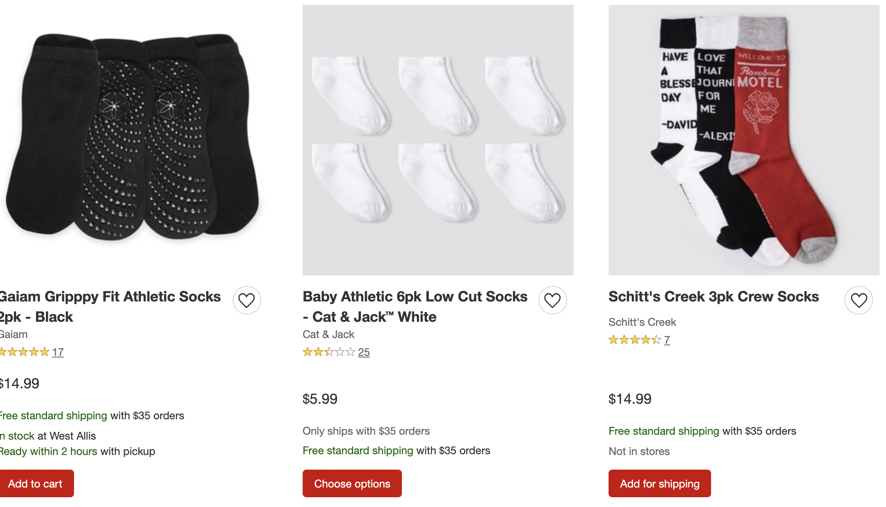
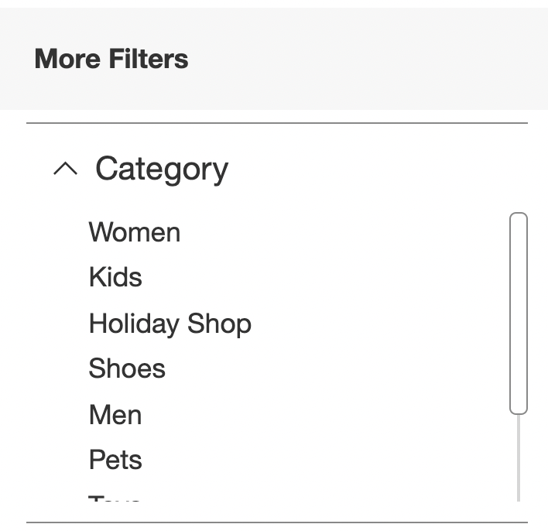
Digital Advertising
Leave, no purchase

Slide 18

Digital Advertising
Pick up in store
Checkout
Add to Cart
Ship

Slide 19
Event Streams
Time

Slide 20
Distinguish Event Types
Purchase

Slide 21
Inferring Labels from Event Types
Past
Label

Slide 22
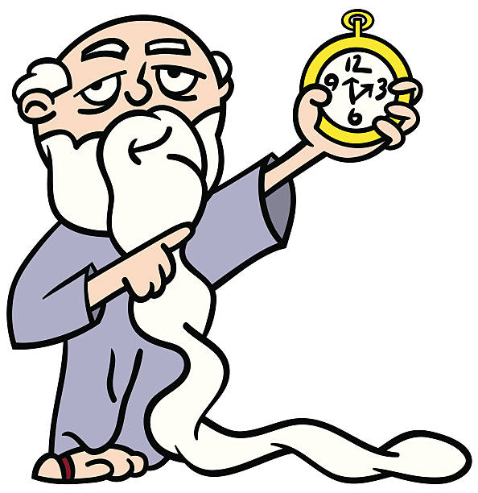
Delayed Feedback
We need to be aware of the delay in the feedback loop
Store data for the past few months or years since labels will arrive much later
Not feasible in some situations: e.g., life insurance policies

